Slide 1
Lab 2

Slide 2
Creating Hello World Example
class Simple{
public static void main(String args[]){
System.out.println("Hello Java");
}
}

Slide 3
Save and run
save this file as Simple.java
To compile: | javac Simple.java
To execute: | java Simple

Slide 4
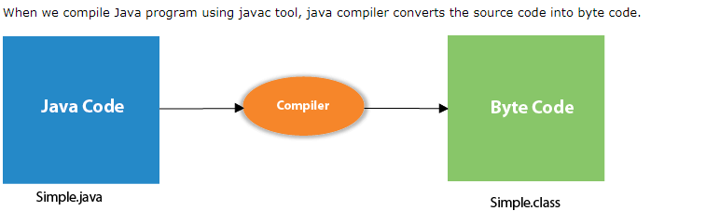
Compilation Flow

Slide 5
Parameters used in First Java Program
Let's see what is the meaning of class, public, static, void, main, String[], System.out.println().
class keyword is used to declare a class in java.
public keyword is an access modifier which represents visibility. It means it is visible to all.
static is a keyword. If we declare any method as static, it is known as the static method. The core advantage of the static method is that there is no need to create an object to invoke the static method. The main method is executed by the JVM, so it doesn't require to create an object to invoke the main method. So it saves memory.
void is the return type of the method. It means it doesn't return any value.
main represents the starting point of the program.
String[] args is used for command line argument.
System.out.println() is used to print statement. Here, System is a class, out is the object of PrintStream class, println() is the method of PrintStream class.

Slide 6
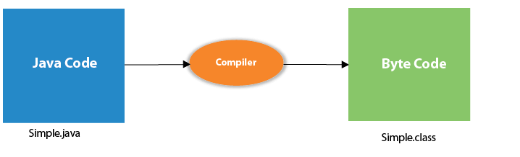
What happens at compile time?
At compile time, java file is compiled by Java Compiler (It does not interact with OS) and converts the java code into bytecode.

Slide 7
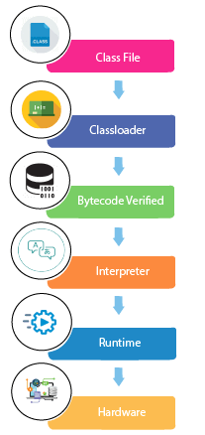
What happens at runtime?

Slide 8
Classloader: is the subsystem of JVM that is used to load class files.
Bytecode Verifier: checks the code fragments for illegal code that can violate access right to objects.
Interpreter: read bytecode stream then execute the instructions.

Slide 9
How many ways can we write a Java program
1) By changing the sequence of the modifiers, method prototype is not changed in Java.
Let's see the simple code of the main method.
static public void main(String args[])
2) The subscript notation in Java array can be used after type, before the variable or after the variable.
Let's see the different codes to write the main method.
public static void main(String[] args)
public static void main(String []args)
public static void main(String args[])

Slide 10
3) You can provide var-args support to the main method by passing 3 ellipses (dots)
Let's see the simple code of using var-args in the main method. We will learn about var-args later in Java New Features chapter
public static void main(String... args)
4) Having a semicolon at the end of class is optional in Java.
class A{
static public void main(String... args){
System.out.println("hello java4");
}
};

Slide 11
Valid java main method signature
public static void main(String[] args)
public static void main(String []args)
public static void main(String args[])
public static void main(String... args)
static public void main(String[] args)
public static final void main(String[] args)
final public static void main(String[] args)

Slide 12
Invalid java main method signature
public void main(String[] args)
static void main(String[] args)
public void static main(String[] args)
abstract public static void main(String[] args)

